Slide 1

Vectors ,motion and forces in two dimension
Dr/Mohamed Tahon

Slide 2
OUTLINES
Vectors and Direction
Projectile Motion
Forces in Two Dimensions.

Slide 3
How do you give directions in physics?
Vectors and Direction

Slide 4



Scalar VS vector
Scalar
Vector
Quantity that can be completely described by one value
You can think of magnitude as size or amount, including units
For example :
A vector is a of magnitude and direction
For example:
Time
Speed
Force

Slide 5
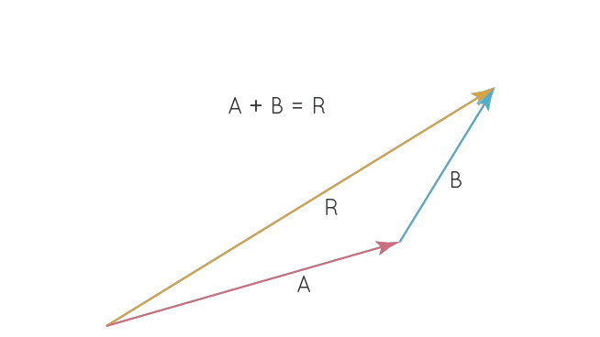
Resultant
Is the sum of two or more vectors added together
You could have walked a shorter distance by going 2 m east and 8 m north, and still ended up in the same place.
The resultant shows the most direct line between the starting position and the final position.

Slide 6
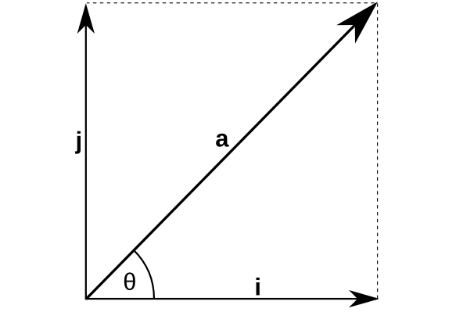
Components
Every displacement vector in two dimensions can be represented by its two perpendicular component vectors
Resolution
The process of describing a vector in terms of two perpendicular directions

Slide 7
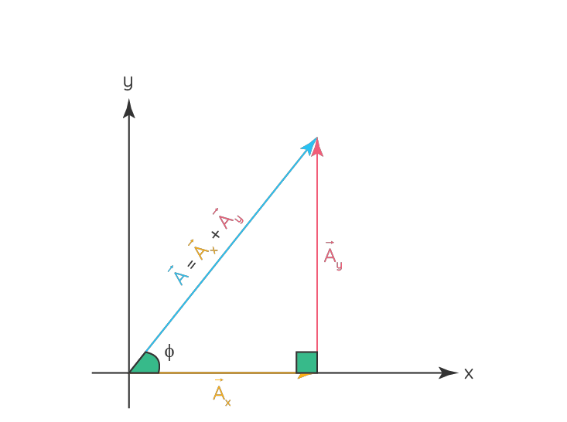
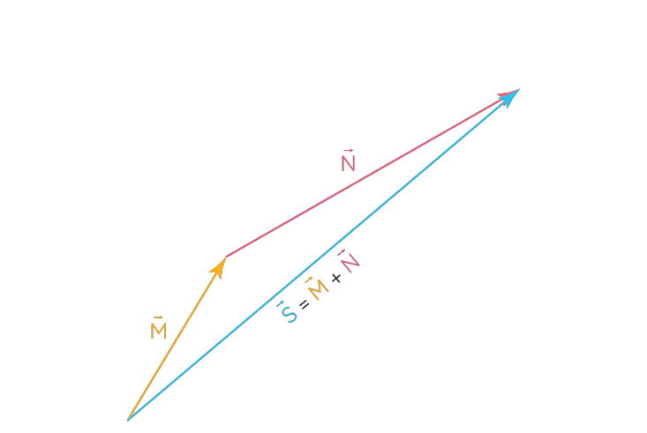
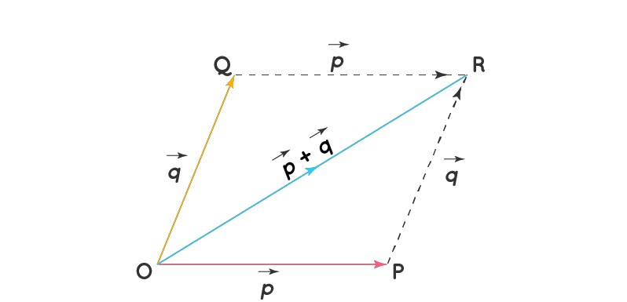
Vector Addition
Vector Addition Using the Components
Triangle Law of Addition of Vectors
Parallelogram Law of Addition of Vectors

Slide 8
Vector Subtraction
R
C = a – b
Q
b
b
a
a
P
a + (-b)
a + (-b)
a - b
-b
a - b
r
-b
S
Vector Subtraction by Parallelogram Law
Vector Subtraction by Triangle Law

Slide 9
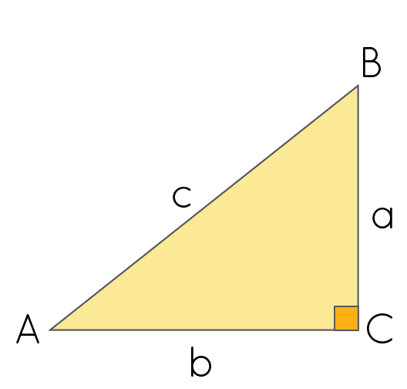
Finding the Magnitude of a Vector
When you know the x- and y- components of a vector, and the vectors form a right triangle, you can find the magnitude using the Pythagorean theorem.
AB² = BC² + AC²​​
a² + b²​​ = c²

Slide 10
How can you predict the range of a launched ball?
Projectile Motion

Slide 11
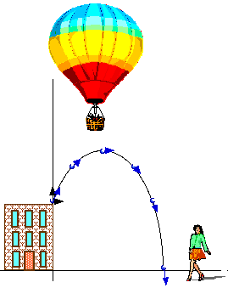
Projectile Motion
Any object that is moving through the air affected only by gravity is called a projectile.
The path a projectile follows is called its trajectory.

Slide 12
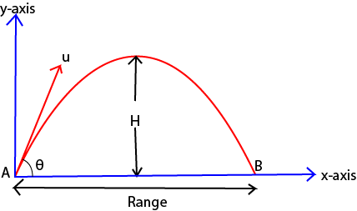
Projectile Motion
The trajectory of a thrown object follow a parabola.
The distance a projectile travels horizontally is called its range.

Slide 13
Projectile Motion
Vx
When we drop a ball from a height we know that its speed increases as it falls, the increase in speed is due to the acceleration gravity, g = 9.8 m/sec 2. down
When a ball is thrown up, we know it starts to slow down too , you can use ΔV y =a y t to find out how long it takes to get to the top
y
Vy
x

Slide 14
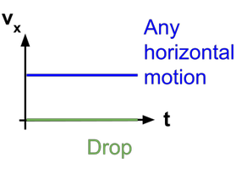
Horizontal motion
The ball’s horizontal velocity remains constant while it falls because gravity does not exert any horizontal force.
Since there is no force, the horizontal acceleration is zero (a x = 0).
The ball will keep moving to the right
The horizontal distance a projectile moves can be calculated according to the formula:
Distance in x(m)X = V * t time in flight(s)
x component of initial velocity(m/s)

Slide 15
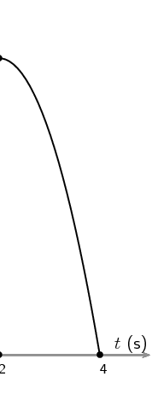
Vertical motion
The vertical motion of a projectile is controlled by the force of gravity. This means that there is an unbalanced force acting on the ball and so the ball will accelerate downwards. This acceleration is 9⋅8ms−2 (the gravitational field strength on Earth).
y
y | Distance in meters
v | x component of initial velocity(m/s)
g | Acceleration of gravity.
T | Time in fight(s)
Vertical distance formula:
y = vt²- 0.5gt

Slide 16
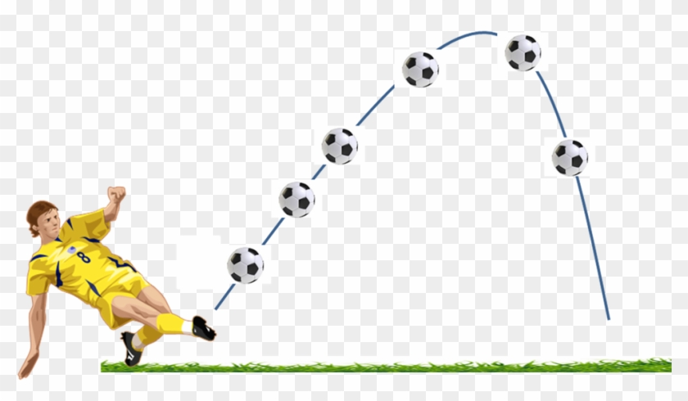
Projectiles launched at an angle
A kicked soccer ball kicked is also a projectile, but it starts with an initial velocity with vertical and horizontal components.
The launch angle determines how the initial velocity divides between vertical (y) and horizontal (x) directions.

Slide 17
How do forces balance in two dimensions?
Forces in Two Dimensions

Slide 18
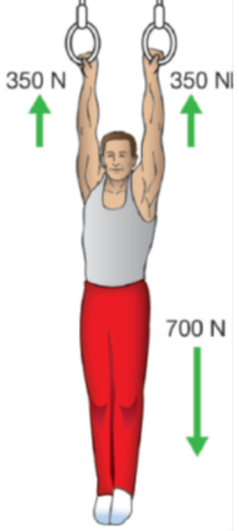
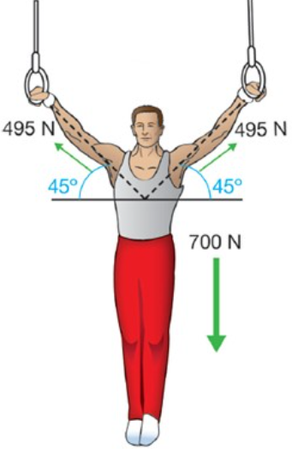
Forces in Two Dimensions
Force is also represented by x-y components.
Force Vectors :
If an object is in equilibrium, all of the forces acting on it are balanced and the net force is zero.
If the forces act in two dimensions, then all of the forces in the x- direction and y-direction balance separately.

Slide 19
Forces on an inclined plane
An inclined plane : is a straight surface, usually with a slope
the greater the tilt of the surface, the faster the rate at which the object will slide down it.
there are at least two forces acting upon any object that is positioned on an inclined plane - the force of gravity and the normal force. The force of gravity (also known as weight) acts in a downward direction

Slide 20
Motion on an inclined plane
Newton’s second law can be used to calculate the acceleration once you know the components of all the forces on an incline.
According to the second law:
a = F m Force (kg. m/sec 2 )

Slide 21
Thanks
Team work :
Nehad Ashraf Mohamed
Reham Mohamed atta
Aber Ragab Mohamed
Heba Elsayed Waheed
Mariam Shenouda Kamel
Mariam Mohamed Abdelaziz
Yostena Lewis Samir
Remah Tareq Abdullah
Rowida Atia Abdullah
Haidy Ahmed Mohamed
Norhan Gamal Elngar

